Slide 1
Reasoning
Right now, we only get –L and +S mosaics.
In theory, +L mosaic should be next. We already get a few neurons, but its not enough to form a full mosaic.
Maybe it’ll pop out if we increase the number of neurons, or how well these neurons cover the image?

Slide 2
Previous vs new parameters
Previous parameters:
300 neurons
18x18 input images
128 batch size
2M epochs
New parameters:
600 neurons
9x9 input images
64 batch size
2M epochs
2x as many neurons, images are 4x smaller = 8x the coverage
ID: 240421-001039

Slide 3
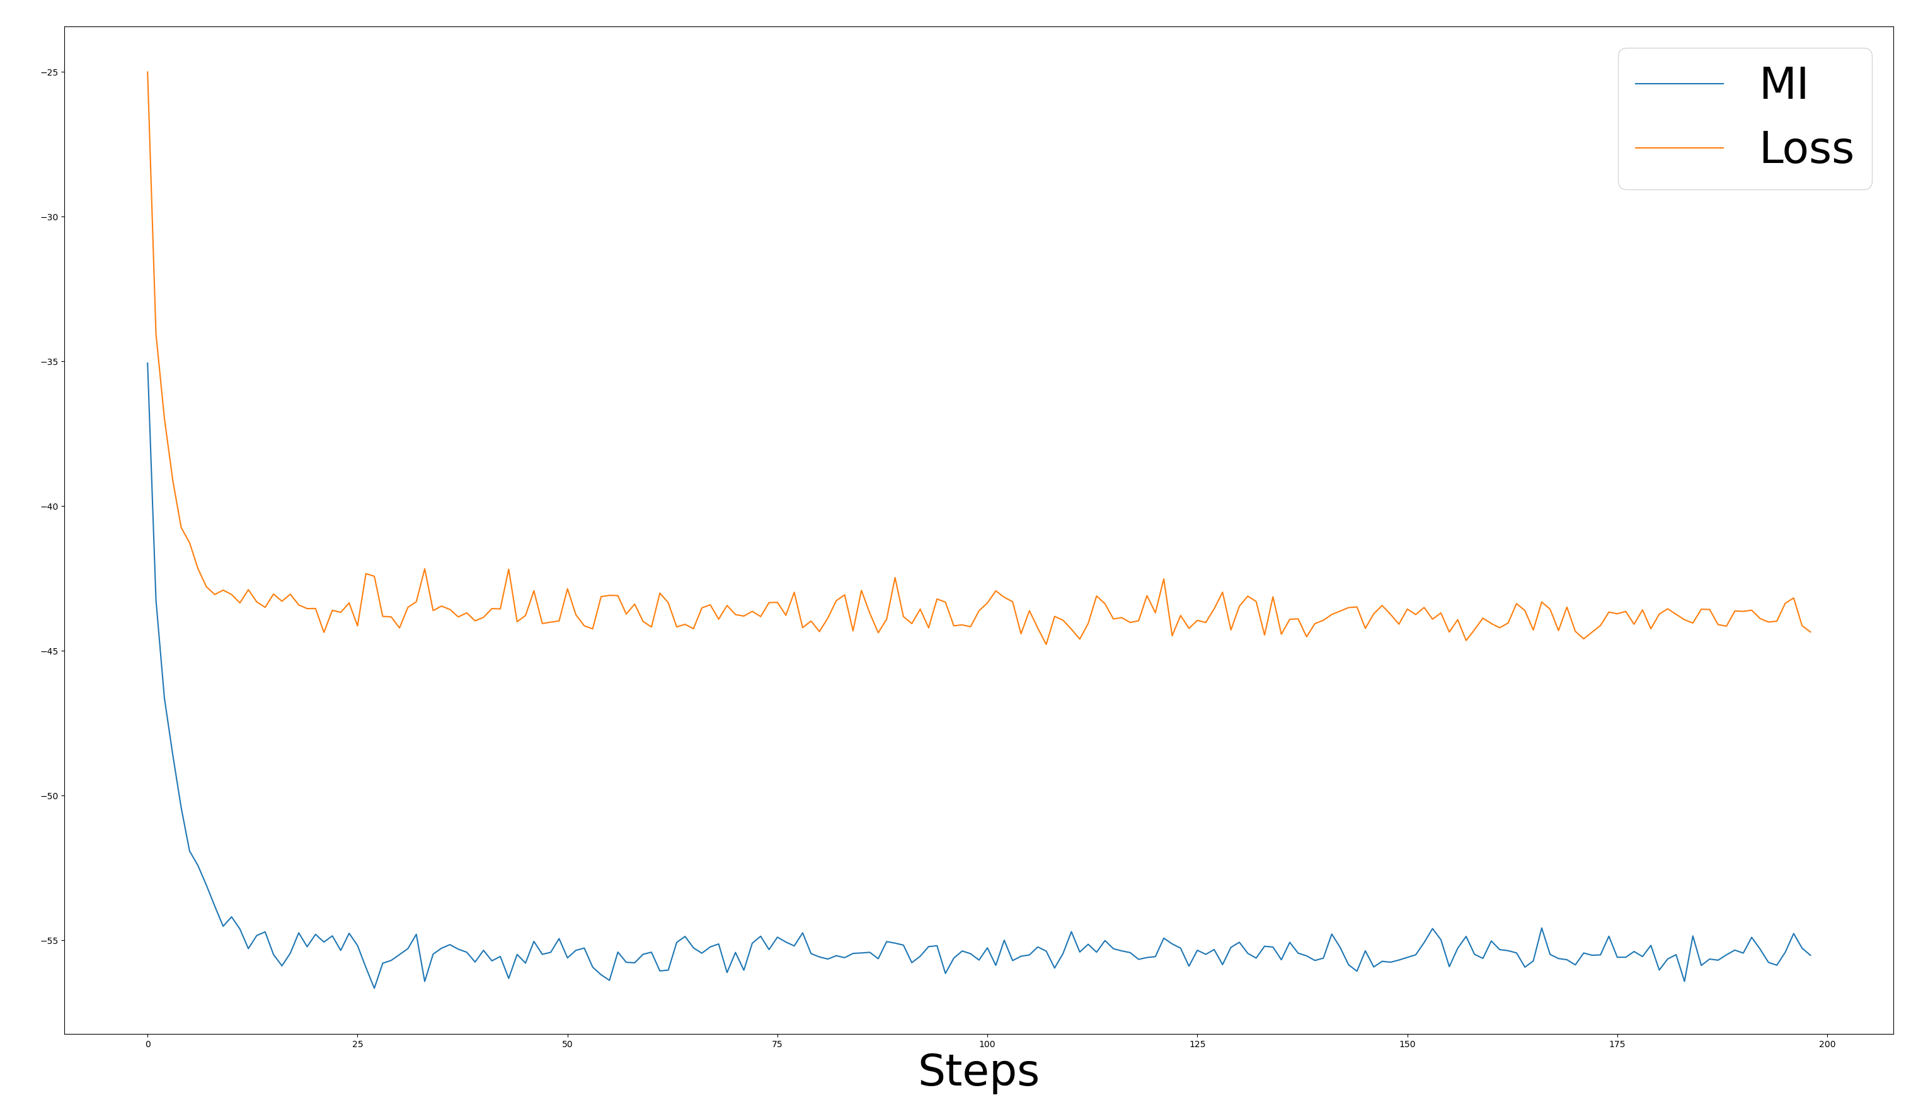

Slide 4
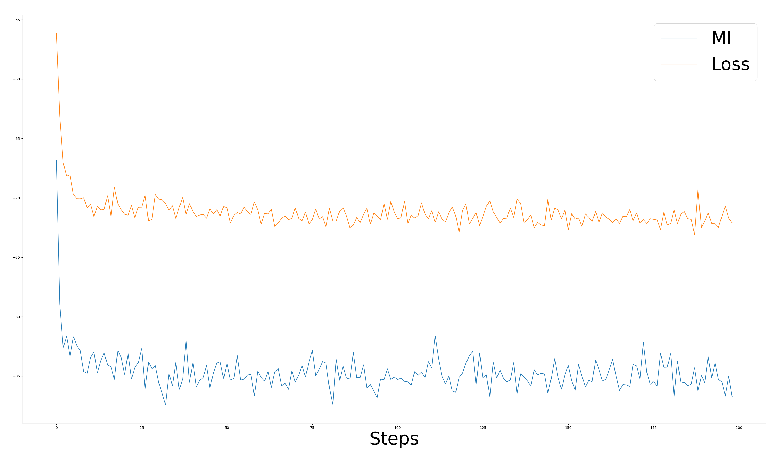
Comparison with previous runs (240301-055438)

Slide 5
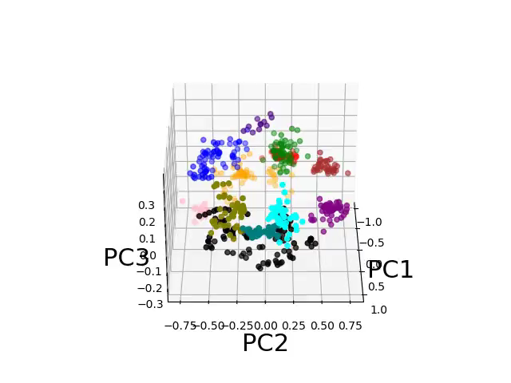
The 3D plot is much more varied, and the clustering algorithm struggles to keep up with the variety

Slide 6
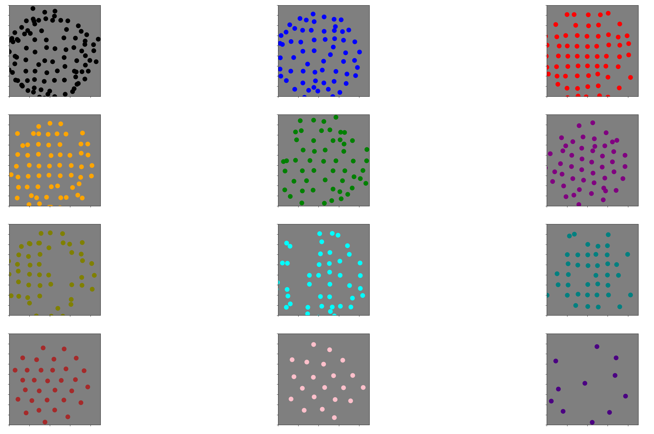
The mosaics aren’t perfect, but that is to be expected with the imperfect clustering

Slide 7
New Bokeh visualization
In general we get a lot more color-opponency
New Bokeh visualization

Slide 8
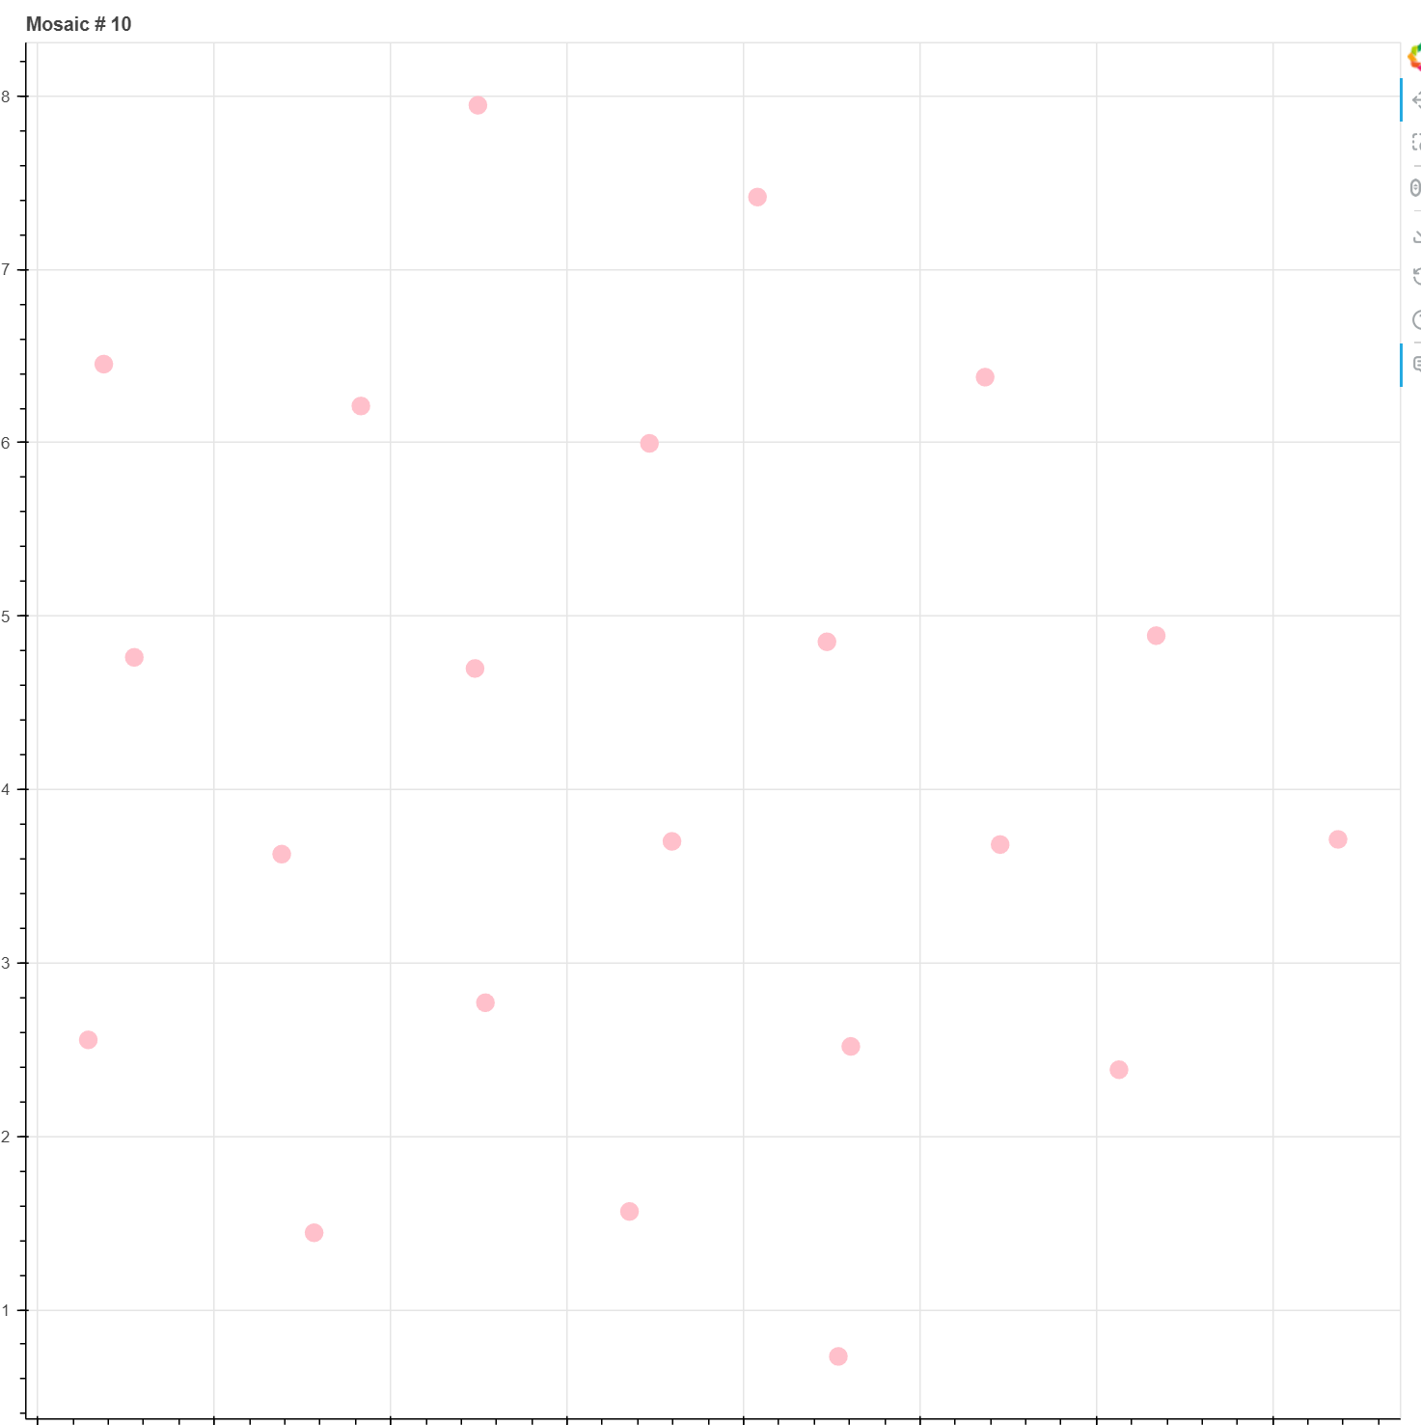
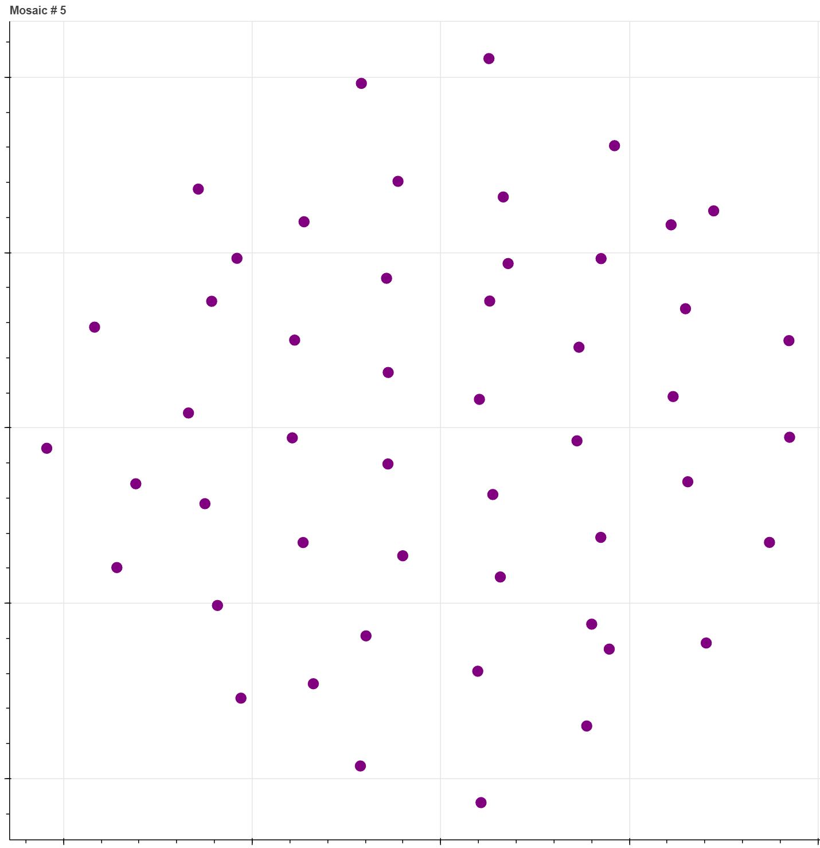
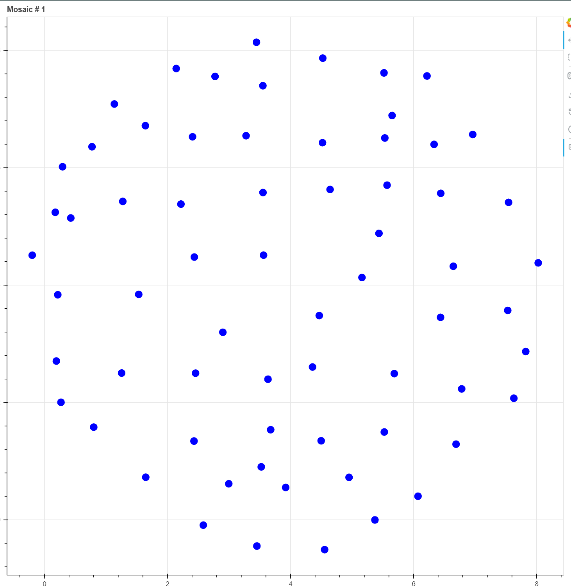
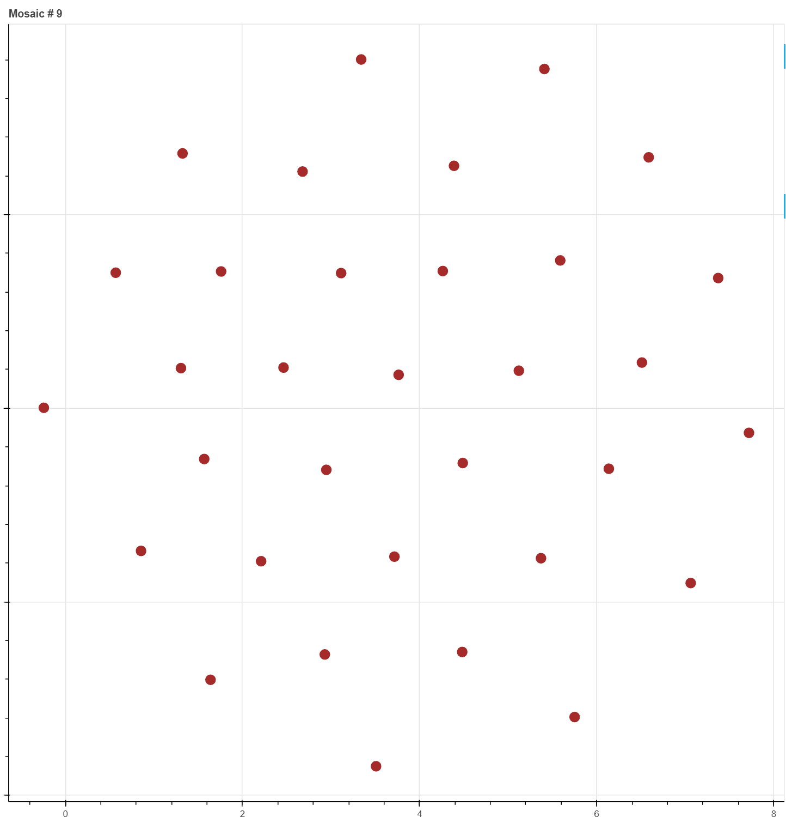
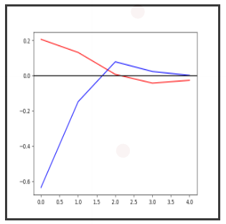
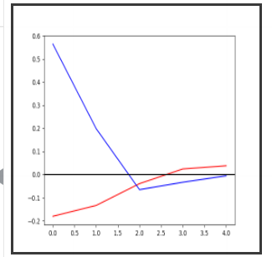
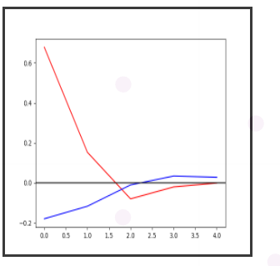
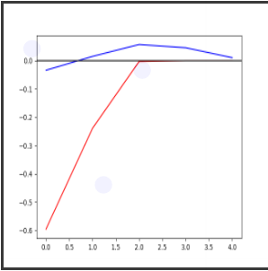
More color-opponency
We get +L, -L, +S and –S mosaics

Slide 9
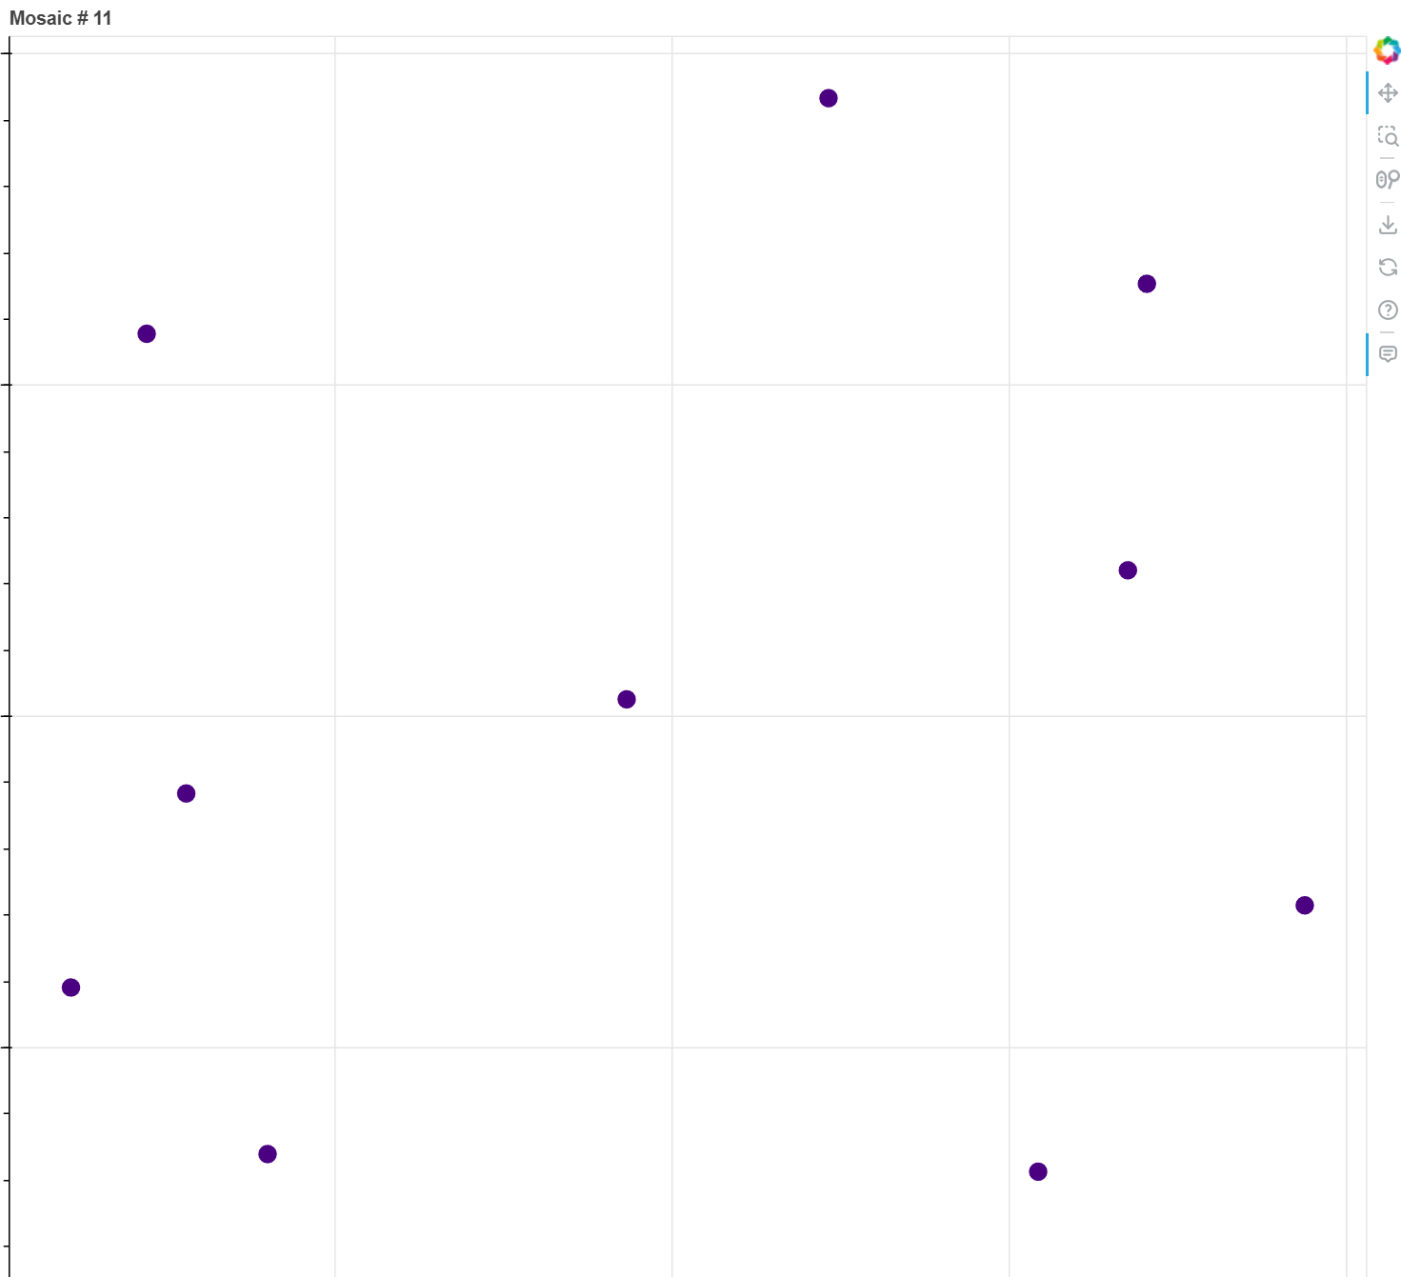
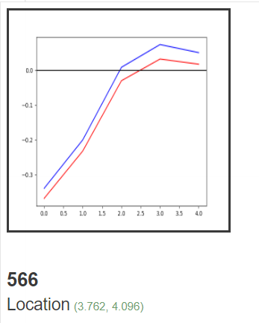
Some of the cells have low Spatial frequency, similarly to Parasol cells

Slide 10
Bug in image flipping code
Oops, I’m sorry

Slide 11
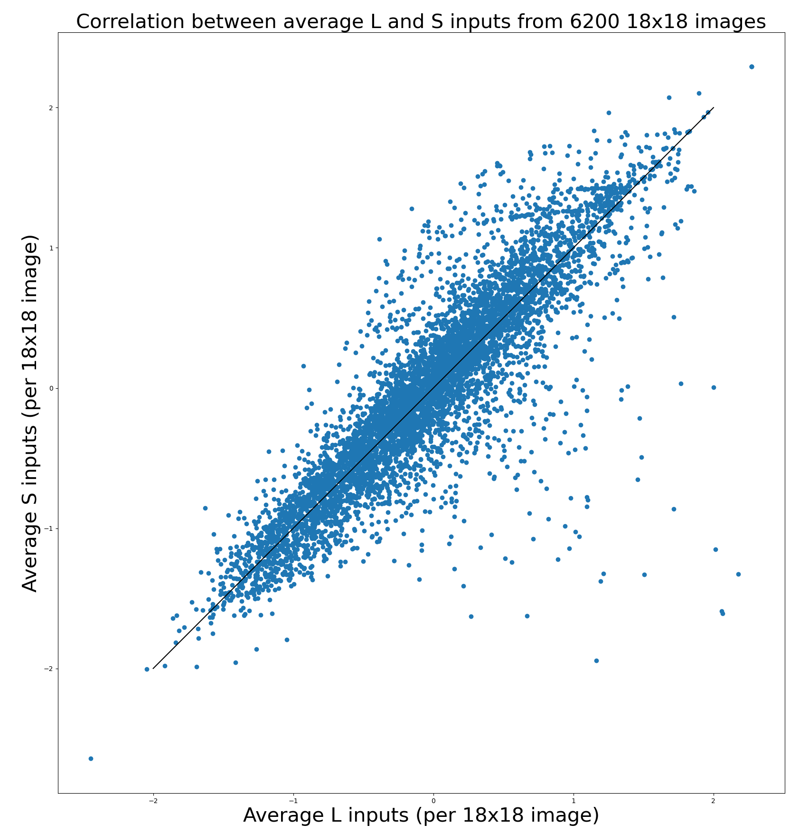
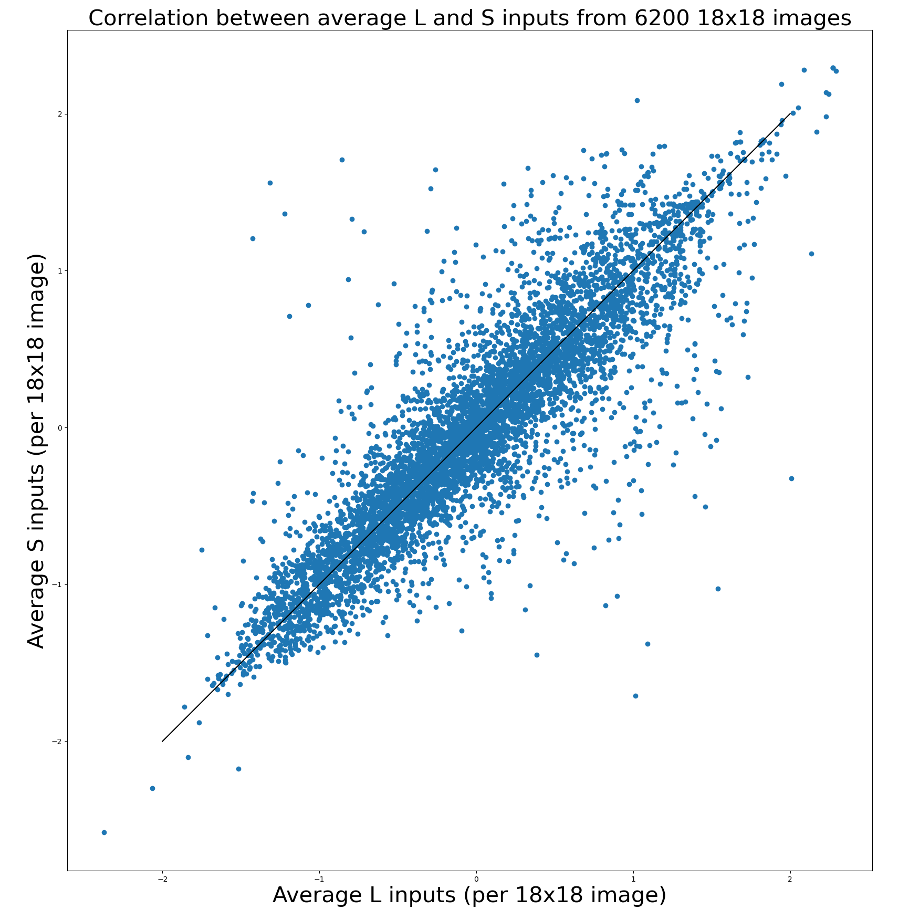
Switching L and S channels for 50% of images
But the covariance matrix was not influenced by that change. So it only changed G

Slide 12
Covariance matrix was not influenced by flip
Bokeh plot after flip to get +L and –S mosaics
PS: Show that 4th mosaic has a few outliers

